Slide 1
LOAN CASE STUDY
Submitted By:
C.BHAGAVATHI(DDA1710429)
Anush B M(DDA1710193)
Parikshit Bhatia(DDA1710352)

Slide 2
Data Exploration
There are 111 variables in the loan dataset.
Problem Statement: To find a solution to minimize the risk of losing money while lending to customers.
So we need to particularly concentrate on the charged_off case.

Slide 3
Data Cleaning and Manipulation
Dealing with Missing values :
In this dataset 54 variables contain all the observations as NA so they are removed.
14 columns have more than 70% of 0 so they are removed.
Some columns are replaced with 0 in the place of NA.
4 columns from remaining has same data in column hence they were removed.
Others:
Rounded of some numeric variables.
Removed “months” from terms and “%” from some variables for visualization purpose.

Slide 4
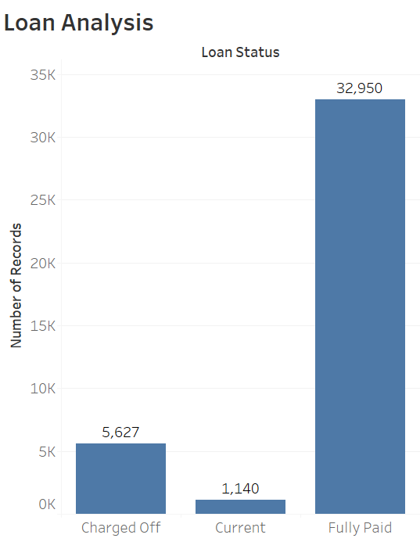
Analysis of loan status
So out of 39717 loans granted 5627 were charged off.
For 1140 members status is current.

Slide 5
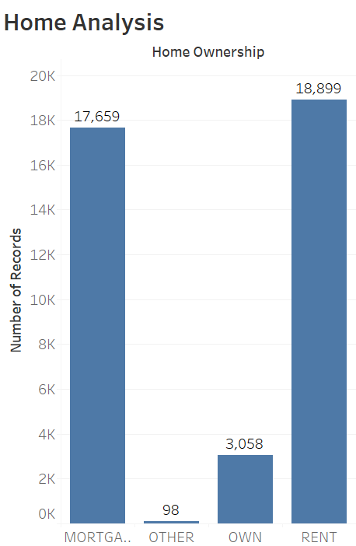
Charged off - home ownership
From the graph it is clear that in charged off case most of the members have rented and mortgage homes.
2839 people are living in rented home.
2327 people are already on a housing loan.

Slide 6
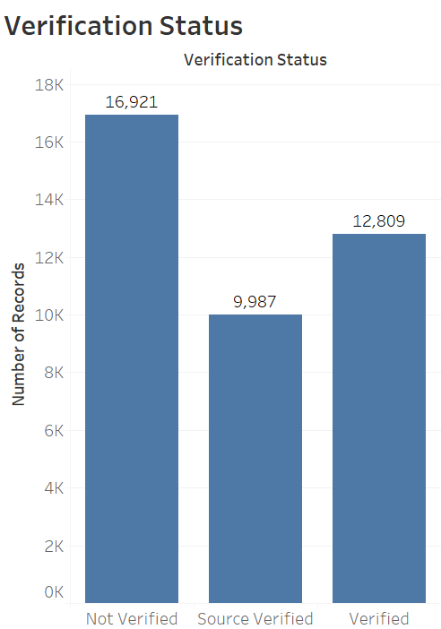
Charged off- Verification Status
This analysis shows the bank’s carelessness.
With out verifying the income of the person they granted loans for 2142 members.

Slide 7
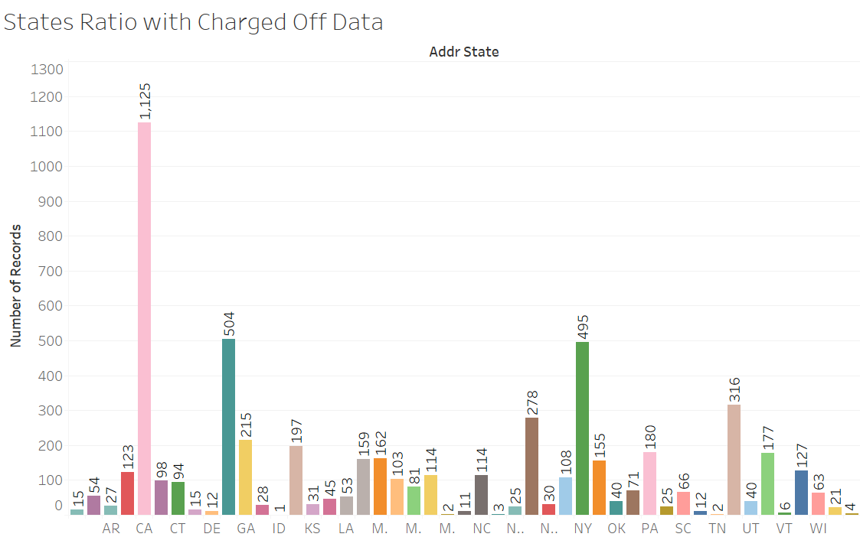
Charged off - State
California state has more charged off status

Slide 8
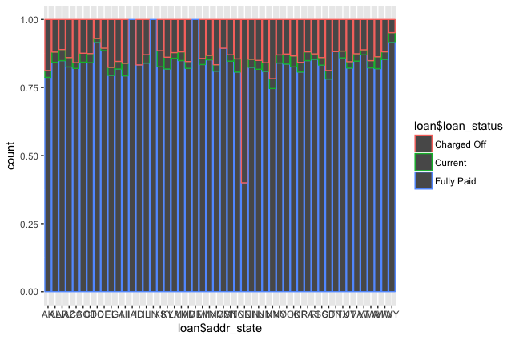
Loan Status with State, NE nebreska is state with highest Default percentage But its an Outlier

Slide 9
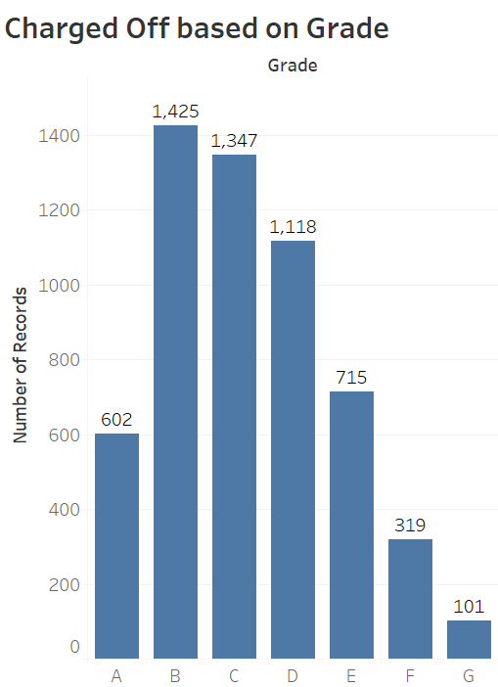
Charged Off – Grade
Most of the charged off occurred in B, C and D grades of loans

Slide 10
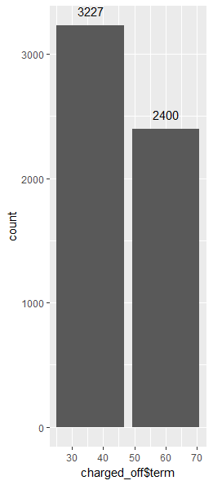
Charged off - term
The number of defaults are more for the people who have the term of 36 months

Slide 11
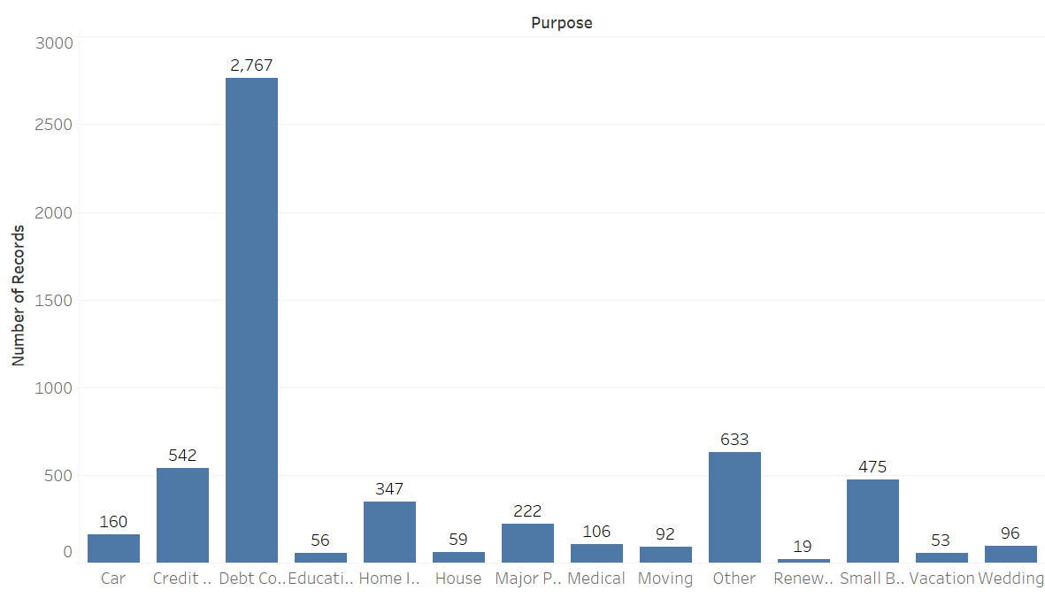
Charged Off - Purpose
2767 Loan defaulted in Debt Consolidation purpose, followed by when
purpose is not specified and is others

Slide 12
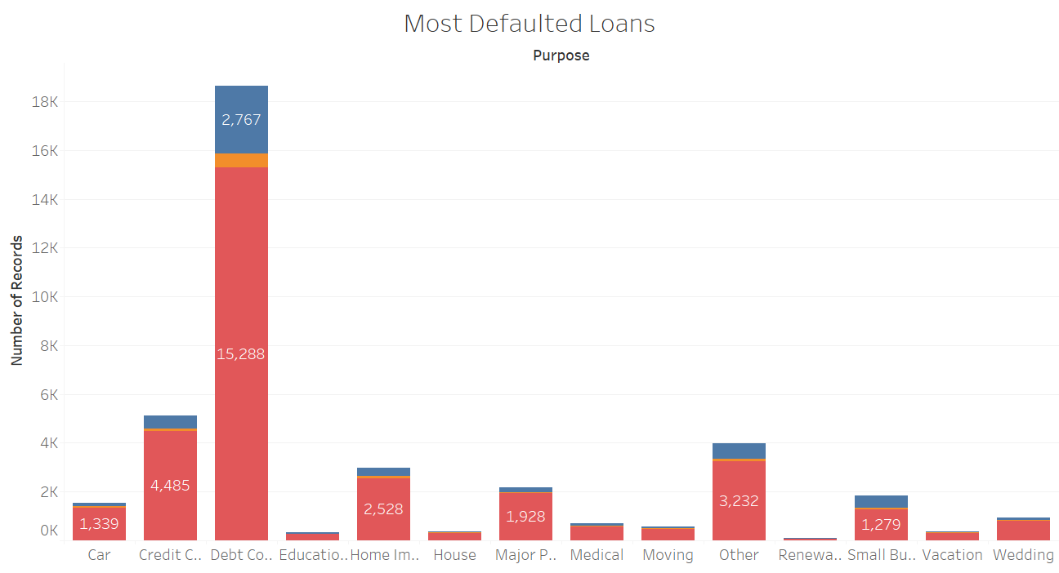
The loans taken for debt consolidation are more defaulted

Slide 13
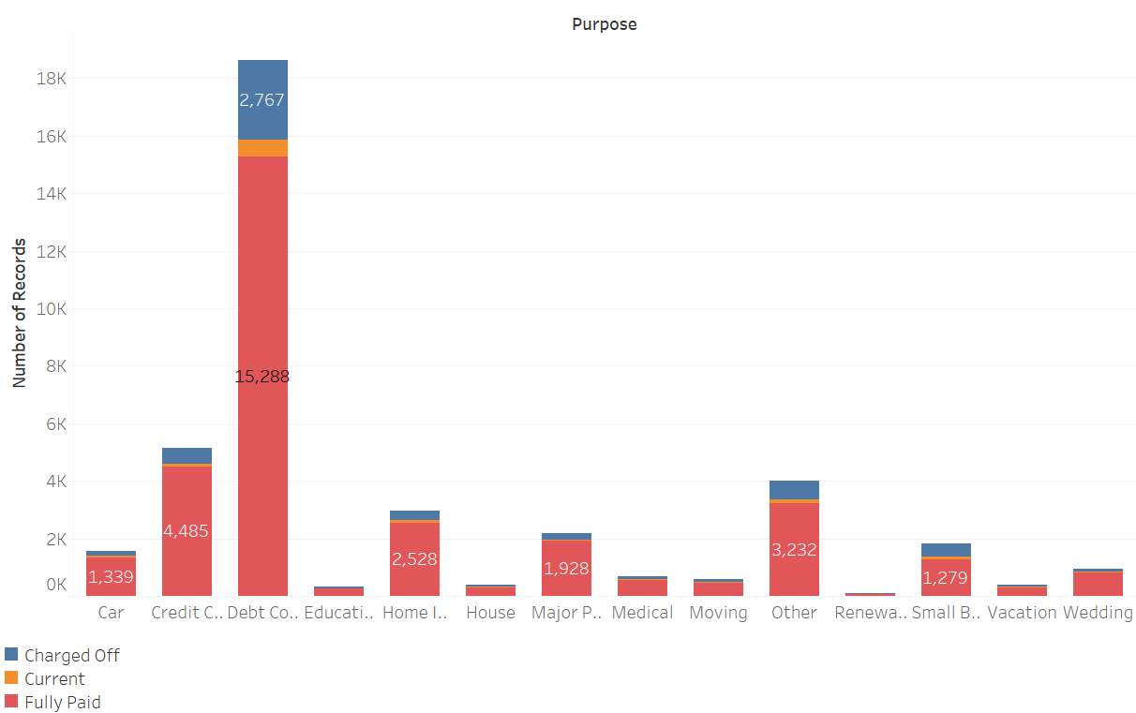
Reasons for Loan and Status
For overall Population of loan we see that higher % of people with purpose as small business as charged off. Overall Debt Consolidation then small Business

Slide 14
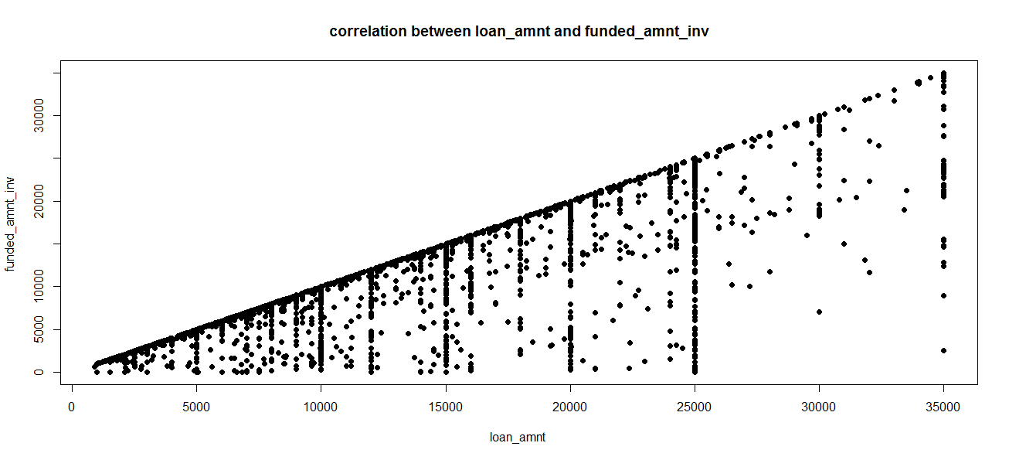
correlation between loan amount and funded amount invested in defaulted case
The correlation is 0.95 and clearly states that with increase in loan amount there is increase in funded amount invested

Slide 15
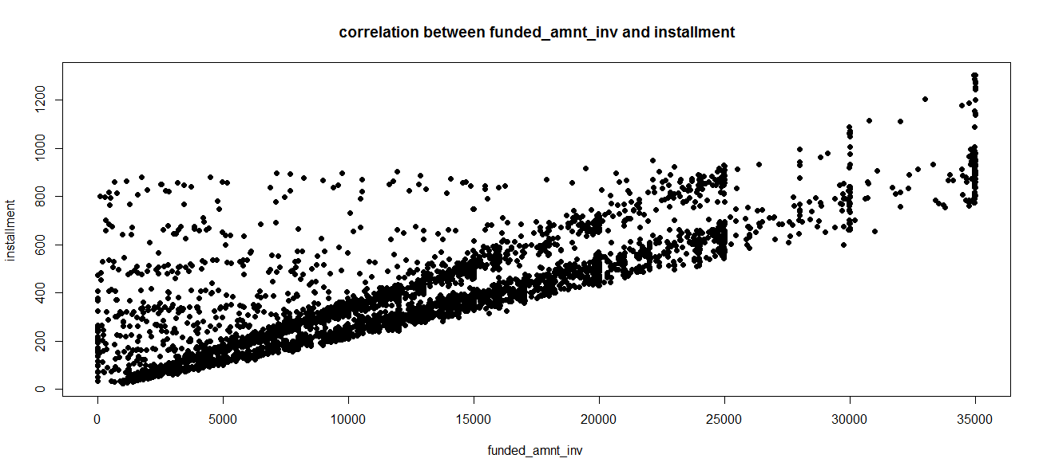
correlation between funded amount invested and installment in defaulted case
The correlation is 0.9 and clearly states that with increase in funded amount invested the installment increases.

Slide 16
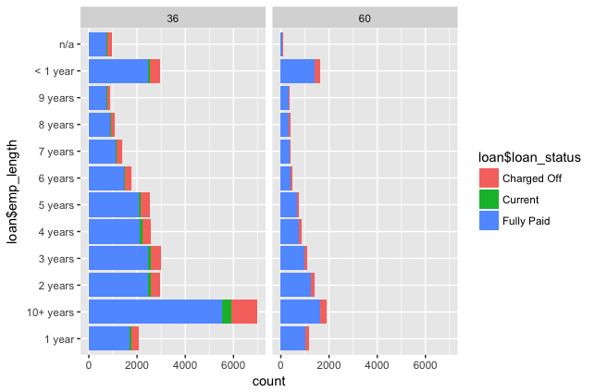
Loan Status with Term to Employee Length, Higher % with 10+ year Employee Length

Slide 17
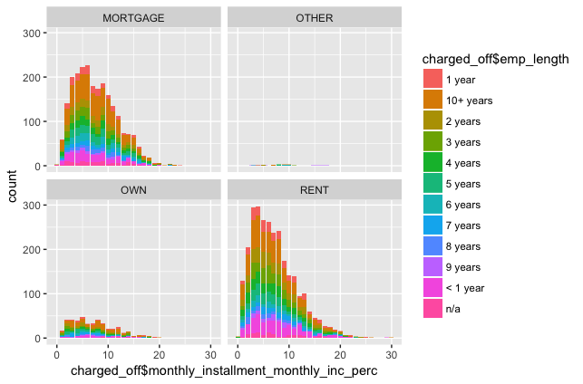
Monthly Installment Percentage Of Salary To Employee length and Ownership
Monthly installment is around 5-10% of monthly income on Mortgage/Rent are high defaulters

Slide 18
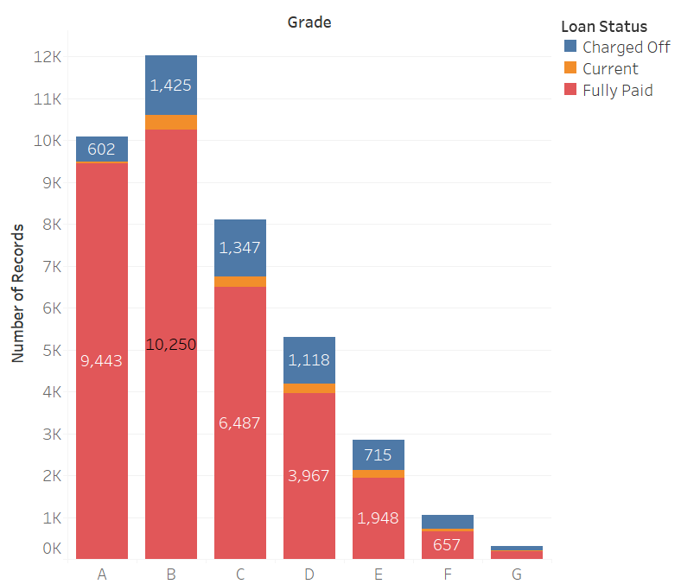
Number of people with Loans at Various Grades
It clearly indicates that People with Grade B have applied for maximum loans and also with highest rate who have cleared loan

Slide 19
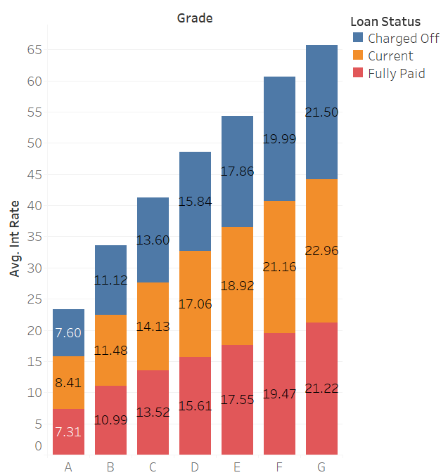
Average Interest Rates at Various Grades
This analysis can help in understanding the average interest rates at various grades. Also to identify the interest rate patterns

Slide 20
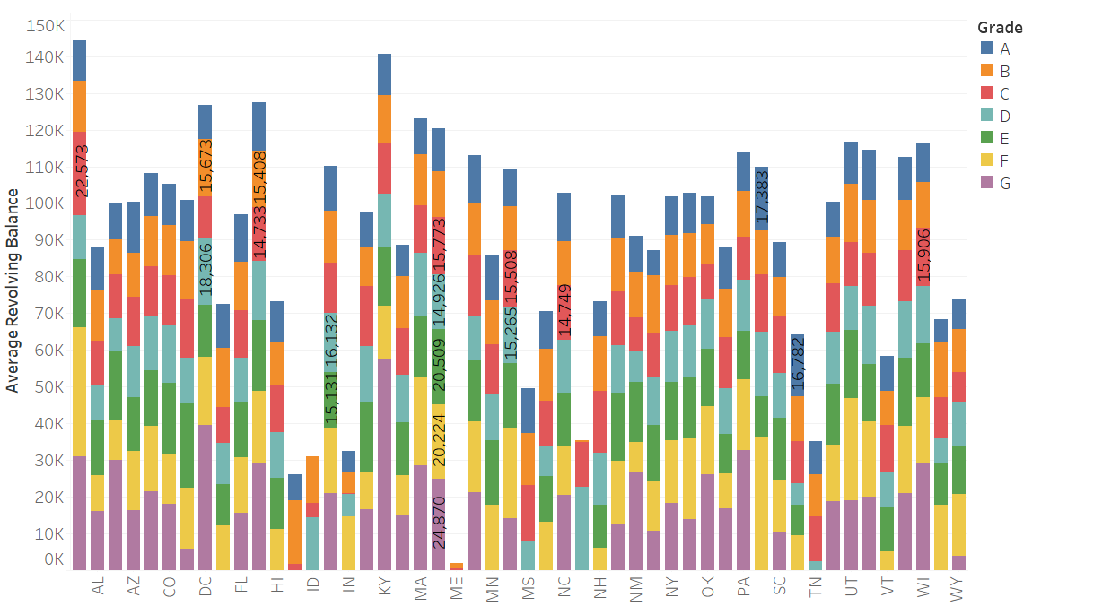
Credit Card Revolving Balance
The revolving balance analysis among various states across all grades helps in identifying in loan processing for the organization.

